Slide 1
Notes:
Review Questions
(Ask the following questions. Select one boy and one girl who each answer a question correctly to be participants in Game #1. Each one will select two teammates to make two teams of three each.)
> Finish this thought -(God wants me to care……… about others.)
> What was last week’s Scripture Memory Verse? (Show love in everything you do. 1 Corinthians
16:14.)

Slide 2
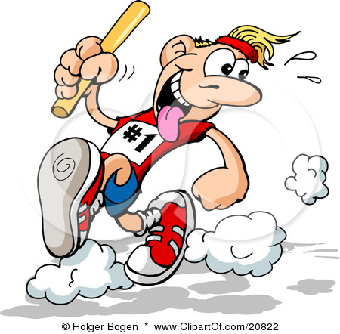
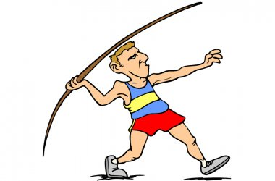
The Kid’s Church Olympics
Hop up and down on one foot five times.
Sing happy birthday out loud to themselves.
Shout : “God can work through me.”
Notes:
Baton Relay
Review Questions
Select one boy and one girl who answer the following review questions correctly to be participants in Game #2. Each one will select four
teammates to make two teams of five each.)
> What country was Ruth from? (Moab.)
> What was Ruth’s mother-in-law’s name? (Naomi.)
Props: 2 toilet paper rolls or construction paper batons.
Participants: Five boys and five girls, two adult leaders.
Playing the Game
Have the boys and girls selected to participate in the game come forward. Divide into two teams ofive children each and have teams line up next to each other as if ready to race. Designate a turnaround spot for runners to race to. Hand the person at the front of each lines a baton. Explain that once kids run to the turnaround point, they must do three different things before running back to their teammates and tagging them: 1. Hop up and down on one foot five times. 2. Sing happy birthday out loud to themselves. 3. Shout today’s Power Point, God can work through me.
Designate two adult leaders to stand nearby the turn-around-spot and help children who have forgotten what they are supposed to do. Also have
them monitor the children to make sure they are completing the tasks asked of them completely. The team that wins the race is the one which has all teammates race and thoroughly complete the assigned tasks.
Props: Long, straight foam noodle, masking tape,permanent marker.
Preparation: Clear out a large area for this game. Make a masking-tape starting line on the floor.
Participants: Three boys and three girls.
Playing the Game
Ask the kids if they’ve ever seen a track meet that included a javelin throw. Mention that we are going to have our own track meet competition. Have the six participants come forward. Invite the first participant to stand behind the masking tape line. Encourage cheering from the audience. Allow the child to throw the javelin (foam noodle) as far as possible. Have an adult helper mark the spot with masking tape and write the child’s name on the tape with a permanent maker. Continue until all children have thrown the javelin. Award applause for the 3rd, 2nd, and 1st place winners

Slide 3
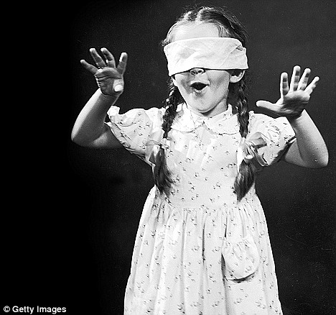
Notes:
Objects: obstacle course objects (chairs, pillows, desks, books, etc.)
Preparation: Have adult helpers blindfold the younger children. Older children should be able to blindfold themselves. Set up an obstacle course
with objects that can be safely maneuvered.
Presentation (Divide the group in two. Have children pair up. Let them know that half of them will be blindfolded and half of them will not. If your group is too large, choose some children to demonstrate for the rest of the group.) Those who are blindfolded need to trust the ones who aren’t blindfolded.
Those who aren’t blindfolded are going to lead the ones who are blindfolded. Allow a few minutes for the blindfolds to be put on. Once the blindfolds are on, show the leaders the designated area filled with obstacles that they must help their partner maneuver. Spend five minutes with children leading their partners. After five minutes are up, allow the children to remove their blindfolds and regroup. Ask, how did it feel to be blindfolded and led around?
(Scary, dark, fun, etc.) What did you notice most when you were blindfolded? (How I wasn’t sure where I was going; that I couldn’t see, etc.) How did it feel to be the leaders? (Invite response.) Was here an element of trust that took place between the pairs? (Allow for interaction and comments.)

Slide 5
Notes:
Today’s Scripture Memory Verse talks about showing love. It doesn’t say we should show love just when we feel like it…it talks about showing
love in EVERYTHING we do!
This verse is easy to understand. It’s pretty straight forward in its meaning. What is one way you could
show love to someone today? (Invite children to give personal examples of what they could do.)\
Talk about the banner on the wall – how have you made the world a better place – anybody have any stories to add?
Why doesn’t this verse say, “Show love sometimes”? Why wouldn’t this be something a Christian would want to memorize? (It’s easy to show love sometimes, when we feel like it. The hard part is always showing love, but that’s what God wants from us!)
Today’s Power Point is God wants us to care about others. Loving people at all times is one of the best ways to show them we care. Love can
be shown in little things, like sharing our snacks or giving of our time. The word “everything” is the key to making this Scripture Memory Verse stick.
It means no matter how we feel we can put those feelings aside and show love in everything! A hard lesson in a very short verse; its something we can do with God’s help!

Slide 6
http://www.youtube.com/watch?v=B-x_7n0gCnU

Slide 7
http://www.youtube.com/watch?v=1nHmfMLTEBg
Notes:
Play charades of Bible Stories
Two Teams – each team chooses a Bible story to act out without words, and the other team has to guess what story it is.
Now have each team come up with actions that will mime every word of the memory verse. Have the kids pair up with each other (1 from each team) and have them teach each other their mime without using words.) have them imitate each other.
In this verse, Jesus was talking to His disciples during the last week of His earthly ministry. He wanted to assure the disciples that He would give
them His Holy Spirit, and that through the Holy Spirit, the disciples would be able to do the things Jesus did on earth. After Jesus’ ascended back to heaven, He sent the Holy Spirit to the disciples to allow them teach and perform miracles as Jesus had.
God can work through us. Just as you guys copied each other to learn the memory verse - did the same things, - we also are to do the same things as Jesus.
How do we imitate Jesus? (Answers will vary. For example, show love, tell people about God, be helpful, do miraculous things in Jesus’ name, serve others.)
How does having faith in Jesus help us follow Him? (We have to believe He keeps His promises. As our faith grows, so does our ability to do as He does.)
PLAY VIDEO

Slide 8
http://www.youtube.com/watch?v=kvon6H5lZXo
Notes:
These kids wanted to pray for things for others. They believed God’s Spirit worked through people to help them do the work of God. In today’s Bible story, Jesus wants His disciples to believe this same truth as well.
Ask the children, have you ever seen anyone who is blind? (Have a show of hands.) How did you know this person was blind? (He used a cane or a seeing-eyedog; he was reading Braille writing with his hands; he needed help and someone was guiding him.) In Jesus’ time the blind may have had canes, but they didn’t have seeing-eye dogs and they couldn’t read Braille. These things really help blind people today so they can function normally in society. In Jesus’ time, blind people couldn’t work; all they could do was beg. Getting around on foot on their own would have been difficult for them because of all the dirt roads and paths. A blind person most likely would have had to be led by someone if he wanted to go anywhere.
(Mention to the children that today’s Bible Lesson is from Mark 10:46-62 and instruct children who have their Bibles to turn to it. Have a boy volunteer come forward and sit down and clutch the wooden bowl, pretending to beg. Hand him the beach towel and have him drape it around his shoulders.)
(Read the following story, guiding the boy to perform his actions when prompted.) “Then they came to Jericho. As Jesus and his disciples, together with a large crowd, were leaving the city, a blind man, Bartimaeus (that is, the son of Timaeus), was begging. When he heard that it was Jesus of Nazareth, he began to shout, (instruct boy to shout, ‘Jesus, Son of David, have mercy on me!’) Many rebuked him and told him to be quiet, (instruct the children in the audience to say, Be quiet!) but he shouted all the more, ‘Son of David, have mercy on me!’” (Instruct boy to shout this.)
“
lesus stopped and said, ‘Call him.’ So they called to the blind man, ‘Cheer up! On your feet! He’s calling you.’ (Have boy stand.) Throwing his cloak aside (have boy throw the towel), he jumped to his feet and came to Jesus.” (Have boy jump up andwalk towards the leader.)
“What do you want me to do for you? Jesus asked him. The blind man said, ‘Rabbi, I want to see.’ (Have boy say this.) ‘Go,’ said Jesus, ‘your faith has healed you.’ Immediately he received his sight and followed Jesus along the road.” (Have boy rub his eyes, rejoice, then
walk off the stage as if following Jesus.)

Slide 9
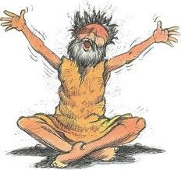
Notes:
Do you remember when you guys were blindfolded. For Bartimaeus, this kind of interaction was a daily occurrence. He had to be helped around and he often begged not knowing if someone was throwing money into his bowl or simply making fun of him in front of his face! Jesus, however, changed all of that. Bartimaeus had faith that Jesus would heal him and when He did, Bartimaeus followed Jesus.
His life was changed. Jesus wants to change your life, too! Today’s Power Point God can work through me can be as life-changing for you as it
was for Bartimaeus. All Jesus asks is for us to follow Him. Something everyone in this room today can do…with great results!

Slide 10
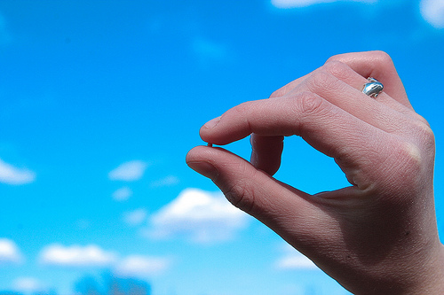
Notes:
Mark 11:24b tells us “believe…and it will be yours.”
Bartimaeus believed that Jesus could heal him and he was healed!
God can work through YOU—too - everyone in this room. Do you really believe it? If so, shout, “I believe!”Louder, “I BELIEVE!” If Jesus is in your heart, then He plans to do great things through you. Your prayers will be answered. Your life is in His hands.
He’s working through you. I believe God is going to do great things through each one of you here today.
Matthew 17:20b, NIV says, “If you have faith as small as a mustard seed, you can say to this mountain,
‘Move from here to there’ and it will move. Nothing will be impossible for you.”

Slide 11
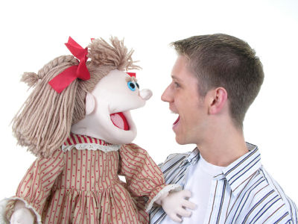
Notes:
Shannon and puppet illustration

Slide 12
Notes:
Welcome to
adventures with the K.I.D.S. Church Kids.
I want to introduce you to Marcus, Jessica, Tyler, Olivia and Gabriel. And Shannon, their Kid’s Church Pastor has just called them together to give them a mission!
Let’s discover what it’s all about.

Slide 13
Notes:
The kids excitedly gathered into the Kid’s Church Leaders office as Shannon told them about another mission opportunity. The
kids had a long holiday weekend, and they had decided they would spend it helping others. Shannon passed out pictures of a First Nations Reseve. Some pictures showed the poor condition of the houses. He explained that the people lived below the poverty level and couldn’t afford
to fix up their homes. “There are so many homes. How can we know which ones we should fix?” asked Marcus. Shannon replied, “I’ll make a copy of these pictures. You can pray over them and ask God to show you which house God wants to work through on.” “That’s a great idea!” Jessica said, and the other kids agreed.
During the week, the kids prayed over the pictures. When it came time for them to go, the kids gathered outside the van and told one another which house they felt God wanted them to go to. Tyler was amazed. “We all decided on the same house!” Olivia reminded everyone: “Remember, Shannon asked us to pray over the pictures. It looks like God is going to use us to help the people living in this house.” Gabe said “It
sure feels great to know God is directing us on this trip!”

Slide 14
Notes:
>As the van pulled into the reservation, Marcus commented on how run-down the place was. “I’m glad we can help others
who really need it” Olivia said. “There are so many!” Tyler said. Then Jessica remembered a reading from her devotional. “In
Matthew Jesus said there is a large harvest but only a few workers. I guess I know what he means.” “So the harvest is the people here who need help and we are the workers?” Tyler asked Jessica. “Yeah, the people need help and some may need to know Jesus, too” Jessica replied.
Kids, it may seem like there are too many problems in the world and you can’t do anything to help. But Jesus wants you do what you can. He knows there are poor and hungry and hurting people everywhere, but He also knows that as you decide to be used by God, you can do things in His power.

Slide 15
Notes:
“There it is!” shouted Olivia. Marcus and Jessica joined Olivia on the other side of the van to get a look at the house as they pulled up closer to it. Before the van stopped, an older boy ran out of the house, calling back to those inside to come out quickly. A mom and two younger kids came
out slowly and looked at the van and the kids getting out. Shannon introduced himself and the group, and explained what they were planning on doing. The surprised mother said, “Why would you want to help me, since there are lots of people here who need just as much help?”
Jessica showed her the pictures of the houses they prayed over and answered, “All of us prayed and asked God to show us which house to go help.” “We believe God wants us to help you” Gabe told the mother. The mother smiled and invited the group inside the house

Slide 16
Notes:
>Marcus looked at the situation and realized they could do several things. He decided since he was the oldest, it would be best
for him to climb on the roof to fix the loose and missing shingles. He asked Gabe and Olivia if they could work together and
begin painting, and they said “Sure!” Tyler had quickly made friends with the older boy, Dakota. He asked Dakota if he would like to help him fix the railing on his porch. He excitedly said “Yes!” and the two boys began to remove the broken railing with hammers and crowbars. As they
worked, Tyler asked about Dakota’s family. Dakota told Tyler about his dad, who had a gambling problem and wasn’t around much. Then Dakota sadly told Tyler about his sister, Chenoa. She had been born with a bad lung, and she ran out of breath easily. When Tyler heard this, he silently prayed that God would heal her.

Slide 17
Notes:
Jessica volunteered to work on the insideof the house. She saw it needed major cleaning and even fixing some holes in the walls. But she felt God’s Spirit leading her to get to know this family. So, while she picked up the trash, Jessica talked to the mother. The mother’s name was Minda, and she told Jessica about her family. While she was telling the story, Cheona came running in the house and ran throughout it. Minda got a worried look on her face and got up to get her daughter. Cheona didn’t look good when Minda brought her back to where Jessica was cleaning up the trash. Minda explained that she was born with a bad lung. She said it was especially hard on Cheona, because she was her most active
child, and she would sometimes faint after running around.

Slide 18
Notes:
>It was very hot day but the kids were making good progress on their repairs and painting. Gabe and Olivia had one half of the house
painted on the outside, and were working on the front next. Marcus had repaired the back of the roof, and was now replacing the
missing shingles on the front half of the roof. And Tyler and Dakota were nearly finished with rebuilding the broken railing.
After a long, hot day working both outside and inside the house, the work was about finished. The kids gathered together to
talk about their experiences. Tyler told the others about what Dakota had told him about his sister, Cheona. Jessica said her
mother, Minda, also talked to her. “I prayed for God to heal Cheona, but just to myself” Jessica confessed. “I did too, after Dakota
told me about her” Tyler added. “Jessica, why don’t you pray with Minda and Cheona?” Marcus asked. Olivia added “This could be the very reason God wanted us to come to this house!”

Slide 19
Notes:
>It was dark, but Jessica knew what God wanted her to do. Jessica asked Marcus to come with her and they both knocked on Minda’s door. She was a little surprised seeing them at night, but quickly invited them in. Jessica asked Mainda to get Cheona and they sat together. Jessica
explained to Minda, “Because we believe in Jesus, we live differently. He teaches us to live like Himself. We believe Jesus gives us
the strength to do the same things He does. Jesus helped people like we are doing for your house. But He also healed people, and
we want to ask Him to heal your Cheona.” Minda thanked Jessica and agreed to pray. Jessica prayed and asked God to heal Cheona’s bad lung. Minda also told Jessica that she wanted to live like Jesus, too. So, Jessica and Marcus explained to Minda how
to be saved.
Kids, just as these kids were used by God, you can be too. That might mean helping someone who need help, telling others about Jesus, or even God using you to pray for healing or some other miracle. Remember, God can work through you. The question is, will you let Him?

Slide 20
Notes:
Minda awoke early the next morning to the sounds of playing children. She looked out her window and was amazed by what
she saw: Cheona and Dakota were outside playing tag! That was one game she knew Cheona couldn’t play—she would run out of
breath or even pass out if she’d tried. Minda watched for a full five minutes and Cheona seemed to run even faster as she chased her brother. Then Minda fell to her knees and praised God for healing her little girl! As the kids gathered to say goodbye, Minda
praised God openly for Him sending them to show her and her family Jesus’ help, hope and healing. She told Jessica that she would tell her friends about what God has done and hoped that she would see them again.

Slide 21
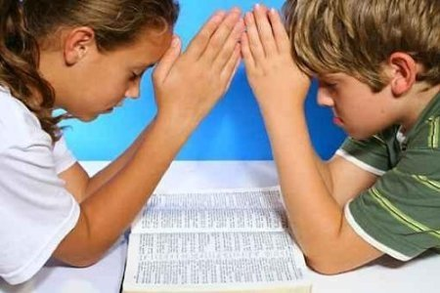
Dear Lord Jesus,
Help us to remember to have faith in you each day.
Help us also to be willing to say God can work
through me. If each of us here could just reach
out to one person this week and share about Jesus
with them, think of the impact we could have! Help
us to replace our fears with faith. Thank you that
you love us and show Your love to us each day.
In Jesus Name. Amen
Notes:
Dear Lord Jesus,
Help us to remember to have faith in you each day.
Help us also to be willing to say God can work
through me. If each of us here could just reach
out to one person this week and share about Jesus
with them, think of the impact we could have! Help
us to replace our fears with faith. Thank you that
you love us and show Your love to us each day.
In Jesus Name. Amen

Slide 22
http://www.youtube.com/watch?v=B-x_7n0gCnU

